Slide 1
Title
Utility-Oriented Visual Evidence Selection for Multimodal Retrieval-Augmented Generation
ACL 2026
Presenter: Zhifng Qin October 22, 2026

Slide 2
Visual Evidence Selection in Multimodal RAG
Retrieve candidates
Select evidence
Generate the answer
Retrieve a pool of potentially relevant images.
Choose K images that help answer the specific query.
The main MLLM answers using the selected evidence.
Selection determines which evidence the model can use.

Slide 3
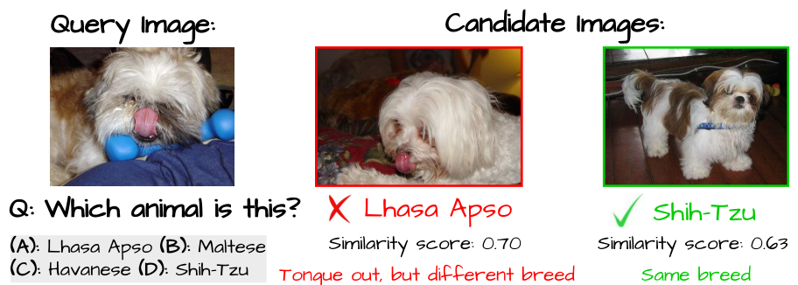
Visual Similarity Can Favor the Wrong Evidence
Similarity 0.70: shared appearance, but a different breed.
Similarity 0.63: the same breed and more useful identification cues.
Takeaway: Evidence selection should prioritize information that helps distinguish the correct answer.

Slide 4
Contributions Overview
1. Problem formulation
2. Latent helpfulness
3. Surrogate acceleration
Define evidence utility through the change it induces in the model’s answer distribution.
Establish a theoretical connection between answer-space utility and binary helpfulness under specified assumptions.
Use a lightweight model to score candidates and invoke the main model once for final generation.
The framework requires no additional training.

Slide 5
Existing Approaches and Research Questions
Existing approaches
CLIP-style encoders and MLLM retrievers or rerankers assess semantic relevance.
Answer confidence can remain high even when the evidence lacks the required information.
RQ1 Which visual evidence helps answer the query?
RQ2 Can utility be estimated efficiently while preserving selection quality?

Slide 6
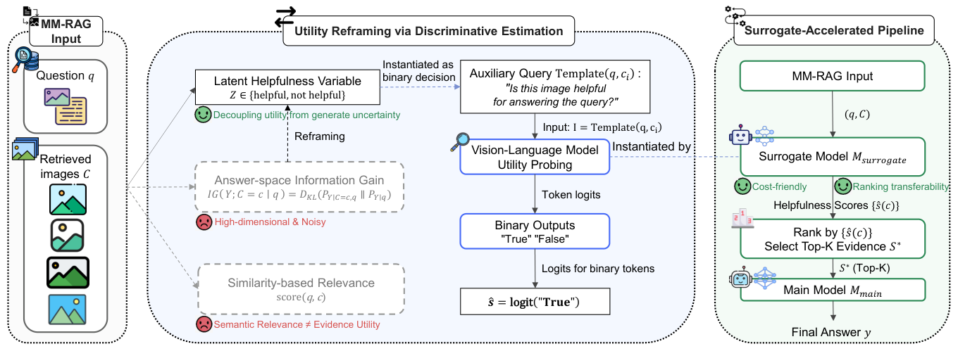
Framework diagram
Main-model scoring: (N + 1) Φ(Mmain)
Surrogate scoring: N Φ(Msurrogate) + Φ(Mmain)

Slide 7
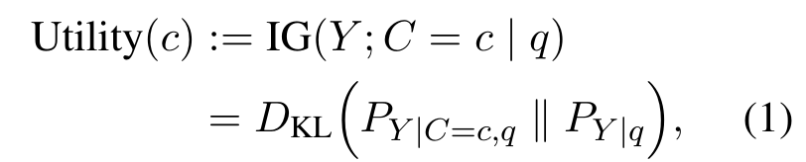

Evidence Utility as a Change in Answer Beliefs
Compare the model’s answer distribution with and without candidate evidence c
Why direct computation fails
1 The full answer distribution is not readily accessible.
2 The answer space is large and unbounded.
3 Linguistic variation, decoding randomness, and hallucinations complicate estimation.
Conditions: non-harmful evidence and a monotone response-mixture structure.
A larger belief shift does not, by itself, guarantee a correct answer.

Slide 8
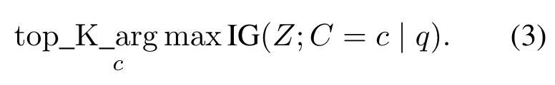
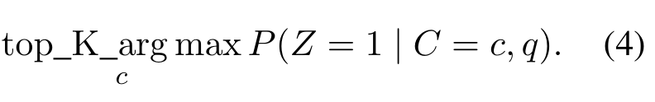
Latent Helpfulness: Theory and Practical Scoring
Z ∈ {0, 1}: whether the candidate helps answer the query
Measures the change in the model’s answer beliefs.
⇓
Represents whether the evidence helps answer the query.
⇓
Provides a simpler ranking objective.
Practical ranking score: raw logit of “True”

Slide 9
Experimental Setup
Benchmark | Query input | Size | Metric
MRAG-Bench | Image + question | 1,353 | Exact-match accuracy
Visual-RAG | Text question | 374 | LLM-as-judge score
Controlled comparison
Same candidate pool for all selection methods; K = 1, 3, or 5.
Default pool: 10 images, including up to 5 annotated evidence images.
Five main-model families; lightweight surrogates perform evidence scoring.
9 / 18

Slide 10
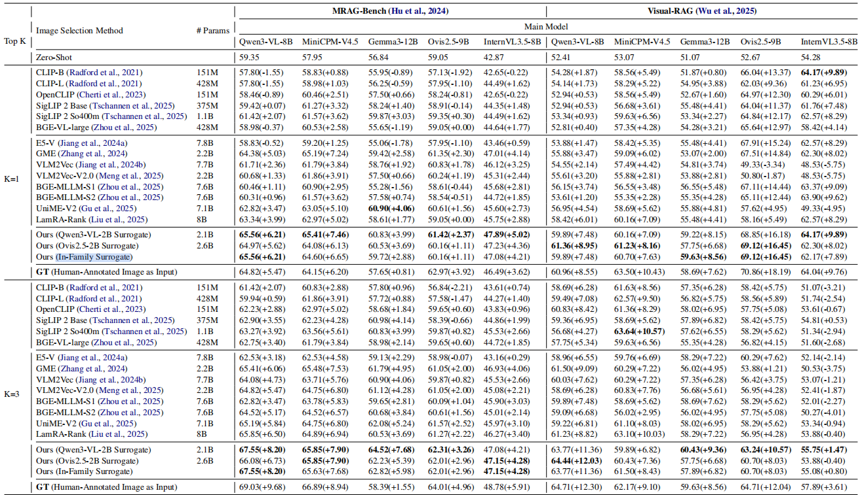
Main Results: Performance Across Top-K Settings

Slide 11
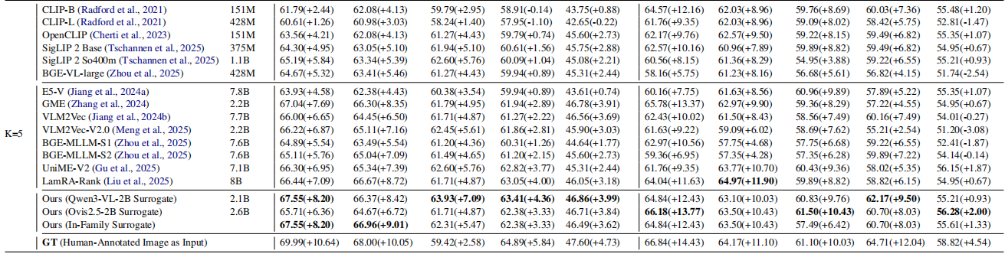
Main Results: Performance Across Top-K Settings
Ours method achieves the best performance in the majority of set tings across both benchmarks, consistently outper forming baselines across various Top-K settings.

Slide 12
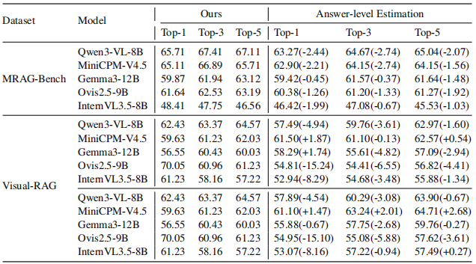
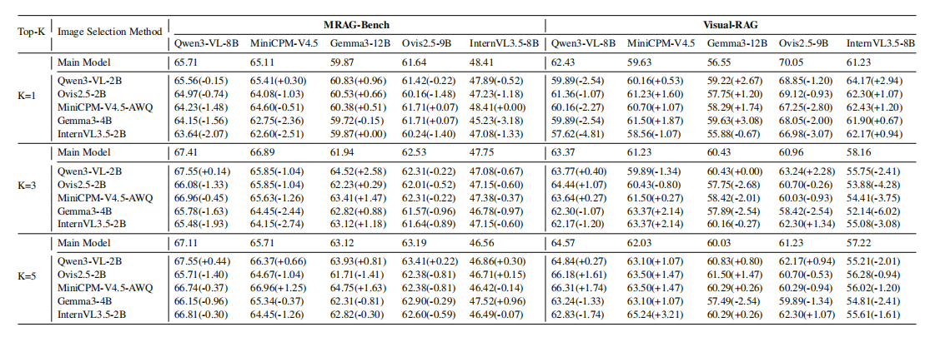
Main Results: Helpfulness Estimation and Surrogate Transfer
Helpfulness-based selection(hidden variable Z) outperforms answer-level estimation (answer space Y) in most evaluated settings, with some exceptions.
Lightweight surrogates achieve broadly comparable downstream answering performance.

Slide 13
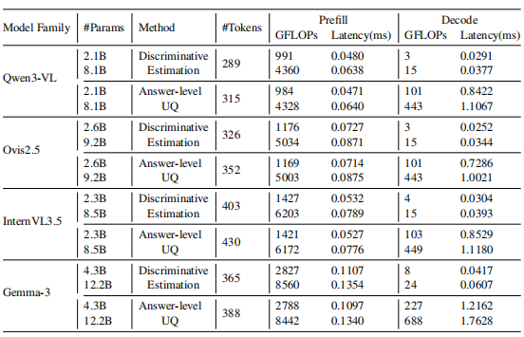
Main Results: Efficiency
2B vs. 8B–12B: prefill FLOPs reduced to approximately 25%.
the Z objective is over 20× more efficient than Y -based estimation
in decoding FLOPs
Conclusion: Direct helpfulness is better than answer-level uncertainty, and decoding costs are significantly reduced

Slide 14
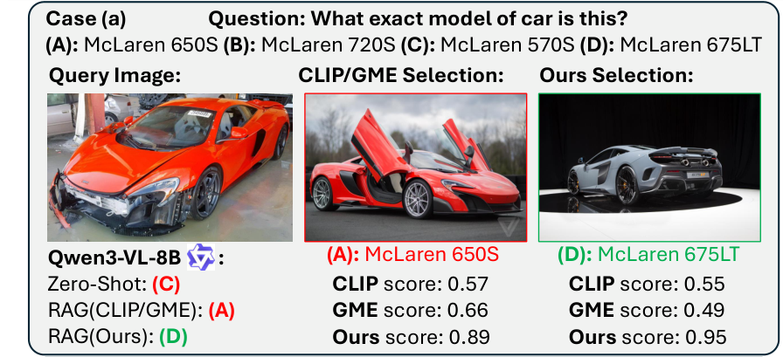
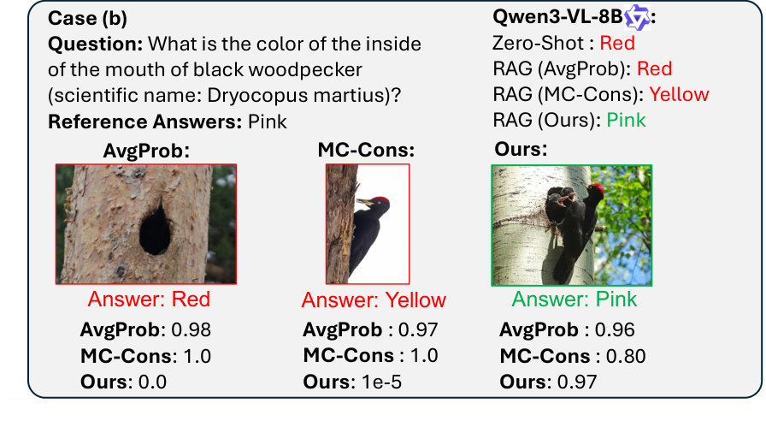
Case Studies
Car identity:
Similarity-based methods favor a car with the same color but the wrong model.
Utility-based selection chooses evidence showing the correct model despite the color difference.
Mouth color:
Answer confidence and sampling consistency remain high even when the selected image does not reveal the mouth.
Utility-based selection favors an image that exposes the visual detail needed to answer the question.

Slide 15
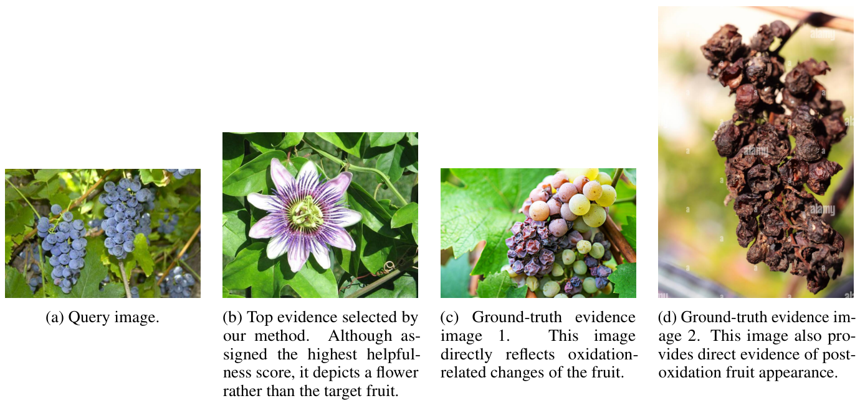
Example of failure
Question: Among these characteristics, which one is improbable for this fruit after oxidation?
Possible explanation
In this case, the surrogate may favor shared plant or scene cues over the physical state relevant to the question.
Limitation: Helpfulness probing remains constrained by the surrogate’s visual reasoning ability.
Selected evidence
- Flower image: 0.852
- Relevant grape images: 0.706 and 0.777

Slide 16
Conclusion and Future Work
Conclusion
1. Propose a utility-oriented framework
2. Reframe the problem into potentially helpful binary classification using information gain
3. And speed it up with a lightweight proxy model.
Future work
1. Systematic Surrogate Design
The paper suggests exploring more systematic strategies for surrogate model selection, adaptation, and dynamic scaling, rather than relying on fixed-size models.
2. Broader Task Generalization
  Future work aims to extend the framework beyond QA-style tasks to captioning, dialogue, long-form reasoning, and interleaved text-visual retrieval.
3. Multi-Modal Expansion
  The current visual-only setting can be broadened to other modalities, such as video, audio, and mixed text-visual evidence selection.

